Slide 1

Chatbot with Augmented Reality
Sanskriti Shukla- 23106128
Prachi Singh - 23106020
Atharv Wadekar - 23106063
Palak Upadhyaya - 23106086
Project Guide
Ms. Taruna Sharma
Academic year 2024-25
Notes:
1

Slide 2
Outline
Introduction
Literature Survey of the Existing Systems
Limitations of the Existing Systems
Problem Statement
System Designs
Technologies and Methodologies
Implementation Screenshots
Conclusion
References
Notes:
2

Slide 3
What is an AI Chatbot?
Artificial Intelligence Chatbots are chatbots trained to have human-like conversations using a process know as Natural Language Processing(NLP). With NLP, the AI chatbot is able to interpret human language as it is written, which enables them to operate more or less on their own.
In other words, AI chatbot software can understand language outside of the pre-programmed commands and provide a response based on existing data. This allows sites visitors to lead the conversation , voicing their intent in their own words.
Notes:
2

Slide 4
What is AR?
Augmented Reality is an interactive experience that enhances the real world with computer generated perceptual information. Using software, apps and hardware such as AR glasses, augmented reality overlays digital content onto real-life environments and objects.
This enriches the user experience and turns one’s immediate surroundings into an interactive learning environment which is particularly valuable in manufacturing and industry 4.0 processes. It allows industrial users to become “ONE” with the systems and machines they work with, and to optimize and augment technology and IOT networks with Human Ingenuity, Networks with Human Ingenuity, Observation, and Creativity.

Slide 5
Integration of AI with AR
Augmented Reality (AR) and Artificial Intelligence (AI) have become integral players in the technological landscape, reshaping the way we interact with the digital world.
AR overlays digital information onto the real-world environment, enhancing our perception and providing a more immersive experience.
On the other hand, AI empowers machines to simulate human intelligence, making decisions, learning, and problem-solving.
The convergence of AR and AI opens up a realm of possibilities, particularly in the realm of chatbots.

Slide 6
Literature Survey of the Existing System
Amazon's Virtual Try-On feature brings the in-store experience to your mobile device by using augmented reality to help you visualize a new pair of sneakers or sunglasses yourself, as well as lip colors and eyeshadow in real time, wherever you are.
Additionally, Lenskart utilizes augmented reality technology to allow customers to virtually try on glasses, facilitating an informed decision-making process.
We are building Chatbot AI with Augmented Reality(AR) for this issues.

Slide 7
Problem Statement
It can help businesses reach new levels of productivity
The problem statement for Augmented Reality and Virtual Reality in e-commerce is that merchants need to find ways to increase engagement between consumers and e-commerce brands, improve buying confidence, and increase sales.
This can be done through the use of AR technologies, which allow customers to preview products and services in their own environment and on their own time before making a purchase.

Slide 8
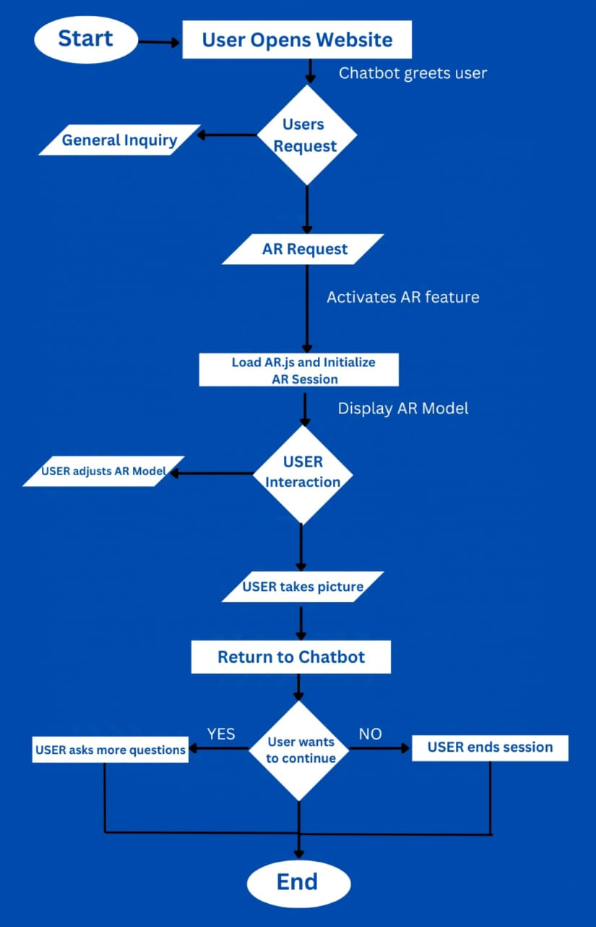
Overview of system design
Notes:
6

Slide 9
Technology stack
AR.js is an open-source JavaScript library that allows developers to add augmented reality (AR) features to websites. AR.js allows developers to overlay 3D content onto real-world scenes using marker-based or markerless tracking techniques.
Both Html, Css, Javascript have their strengths and can be used effectively for AI chatbot and AR development .
Notes:
8

Slide 10
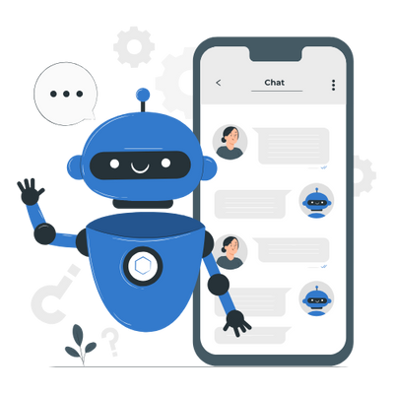

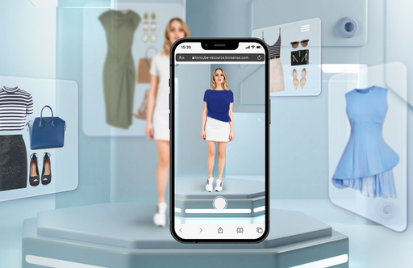
Key features
Uses camera and visual markers to place digital content in the real world.
Users can interact with 3D models, rotate, zoom, and view them from different angles.

Slide 11
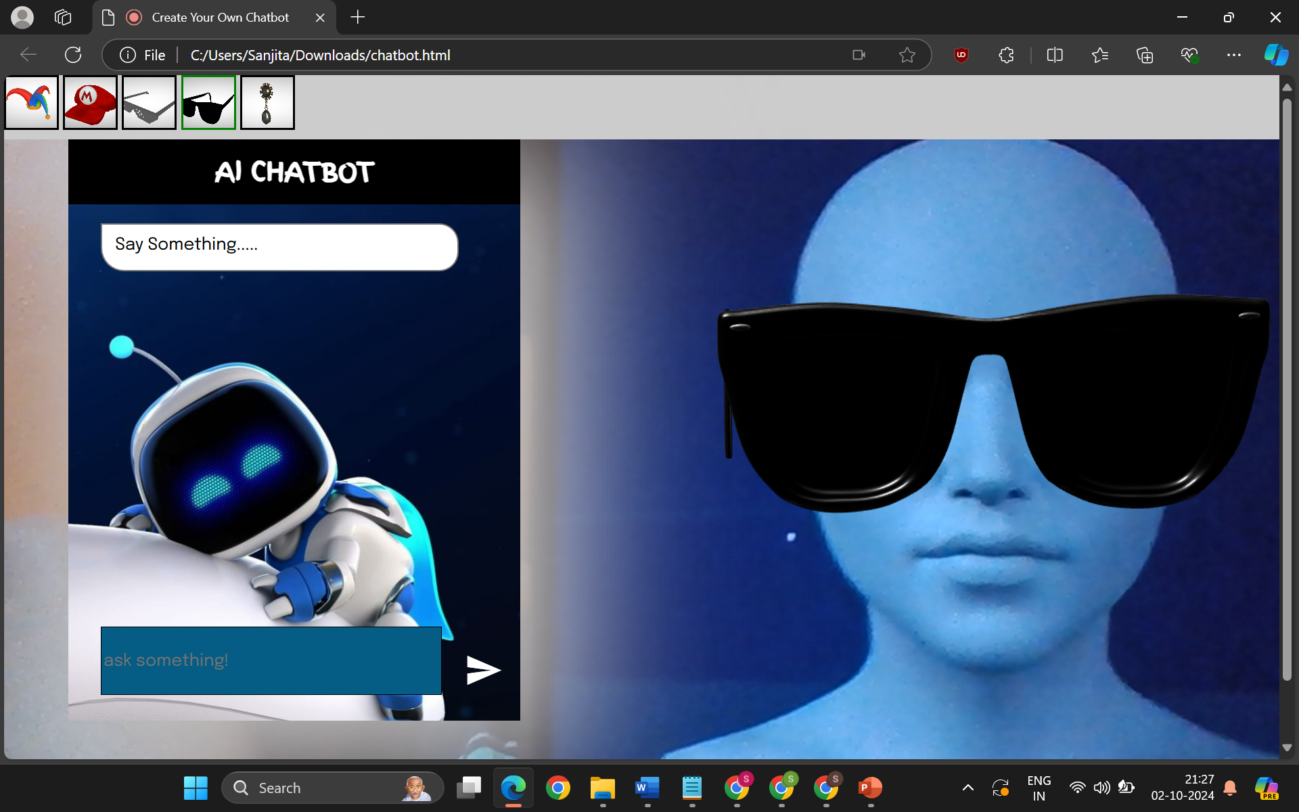
Implementations

Slide 12
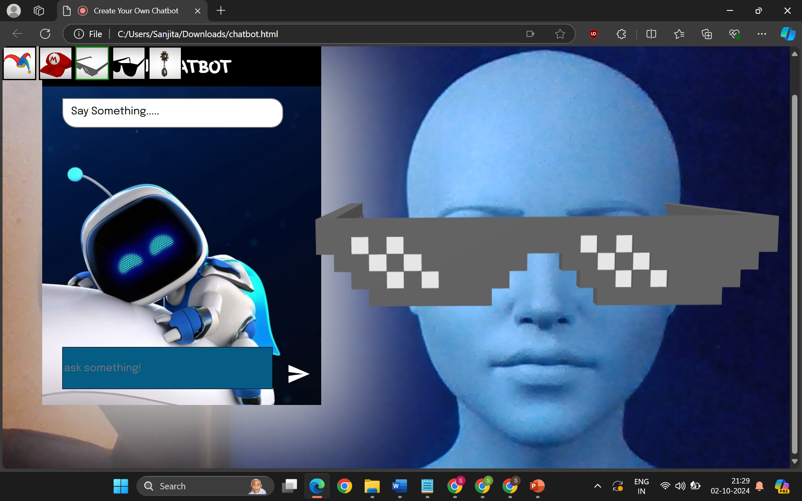

Slide 13
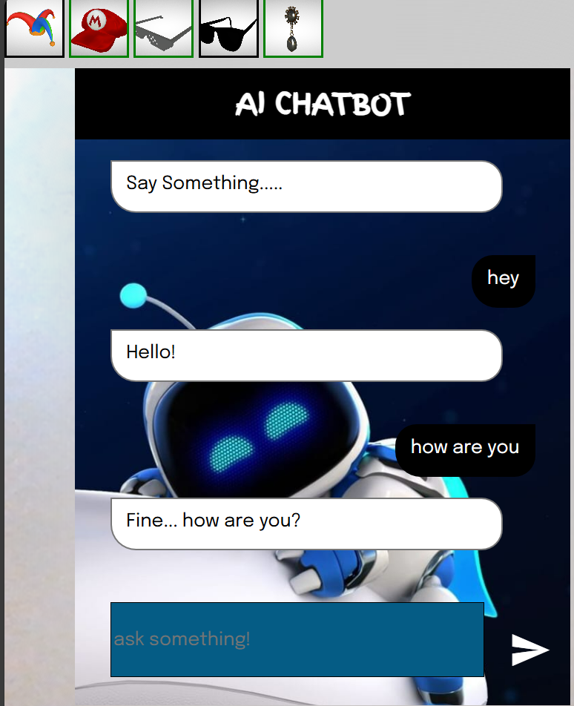

Slide 14
Conclusion
In conclusion, creating a chatbot using HTML, CSS, and JavaScript is an exciting and rewarding project that offers a lot of benefits for businesses and individuals alike.
By following the steps outlined in this guide, you can create a functional and engaging chatbot that can interact with users and provide them with helpful information and support.

Slide 15
References
.Veena Chattaraman , WiSuk Kwon , Kassandra Ross , Jihyun Sung , Kiana Alikhademi Brianna Richardson , Juan E. Gilbert, “ (‘Smart’ Choice ? Evaluating AI based mobile decision bots for in-store decision-making”,” journal of business research (ELSEVIER)”,vol .183, 11 July, 2024.
Bhavana Tiple, Chirag Bulchandani, Isha Paliwal, Deepak Shah, Adamy Jain, Chirag Dhaka, & Vaibhav Gupta, “AI based Augmented Reality Assistant”, “International Journal of Intelligent Systems and Applications in Engineering(IJISAE)”,vol.12, March 6,2023.
Mamatha Mekala, Menda Sandhya, Munnangi Anudeepika Divyasree Nallabani, Hima Sagiraju,“ AUGMENTED REALITY CHATBOT USING UNITY”,“ Dogo Rangsang Research Journal”,vol.11, pp no.11, 01-2021.

Slide 16
THANK YOU...!!
Notes:
9

